Slide 1
FORCASTING A FUTURISTIC CRYPTOCURRENCIES IN TERMS OF COST
Presented By Joshna Devi Rakonda Kiran babu Basnet Student ID :B00619262 Student ID:B00728243

Slide 2
Agenda
Introduction
01
Data Sets i.e. Technical Merits
02
Methodology
03
Result and Discussion
04

Slide 3
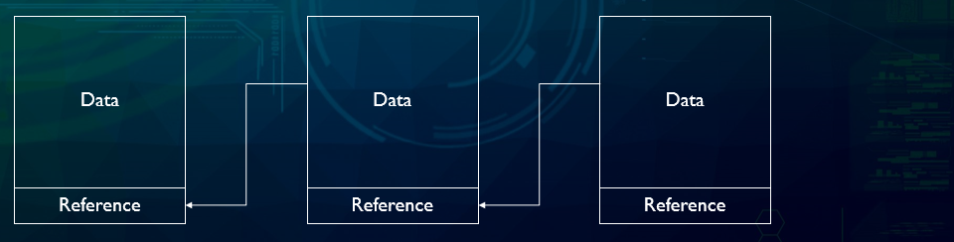
Crypto
There are more then 7000 type of crypto , actively trading . are actively trading in more than 20 000 online exchanges. Their total market capitalization has exceeded USD 300 billion As of 2020, more than 7000 cryptocurrencies are actively trading in more than 20 000 online exchanges. Their total market capitalization has exceeded USD 300 billion a growing list of data blocks that are linked tog data blocks that are linked together.
As of 2020, more than 7000 cryptocurrencies are actively trading in more than 20 000 online exchanges. Their total mark As of 2020, more than 70As of 2020, more than Total market capitalization – 300 Billion cryptocurrencies are actively trading in more than 20 000 online exchanges. Their total market capitalization has exceeded USD 300 billion 00 cryptocurrencies are actively trading in more than 20 000 online exchanges. Their total market capitalization has exceeded USD 300 billion et capitalization has exceeded USD 300 billion

Slide 4
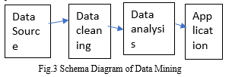
Motivation: To find the crypto that will grow in future.
Problem: Crypto Real time Data sets from 2015- 2021
General Interest of Solving : “To know the future of which crypto ?”
Method :

Slide 5
Evolution
2008
2009
2010
2011
2017
Idea was published under the pseudonym Satoshi Nakamoto
Start of the Bitcoin Network
Fist cryptocurrency stock exchange is launched
One Bitcoin equals one USD
1 Bitcoin equals
10,000 USD

Slide 6
Development
Blocakchain 2.0
Introduction of Bitcoin
2015
EOS
2009
Blockchain 1.0
Etherium.
Future
2018
Blockchain 3.0

Slide 7
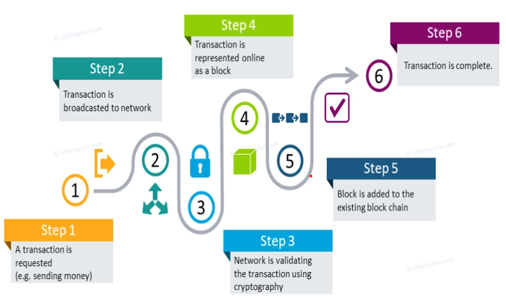
How it works

Slide 8
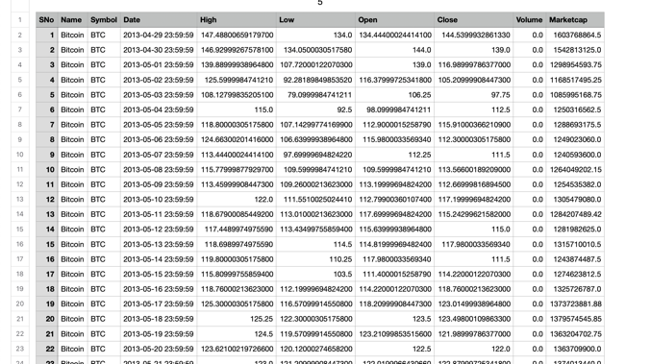
Data sets

Slide 9
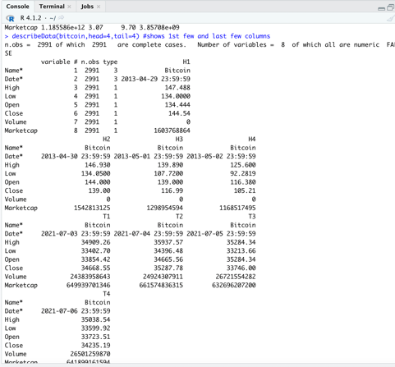
Statistical Analysis

Slide 10
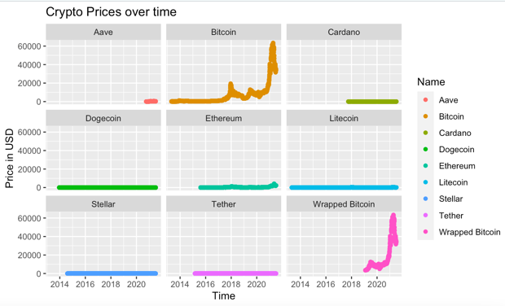

Slide 11
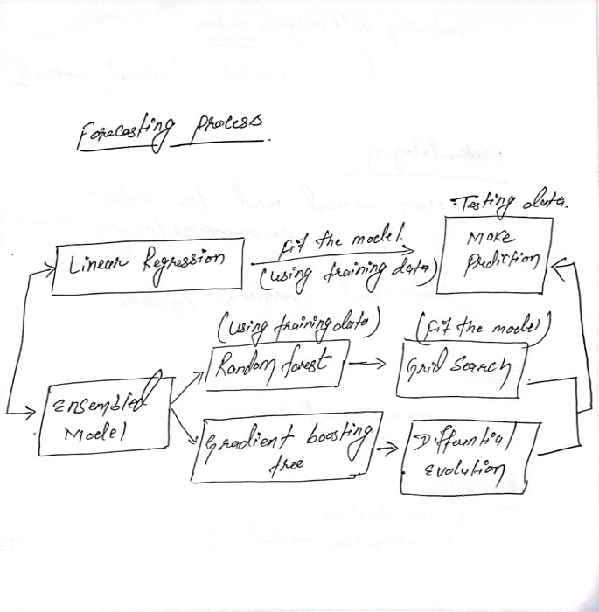
Forecasting Process

Slide 12
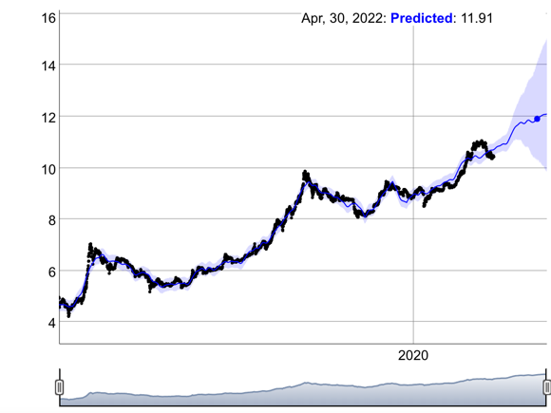
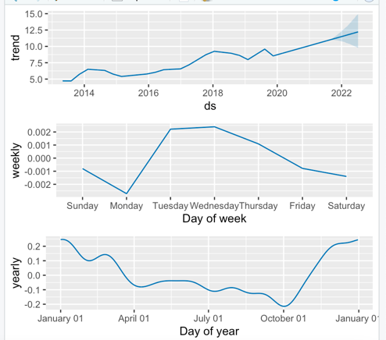
Results

Slide 13
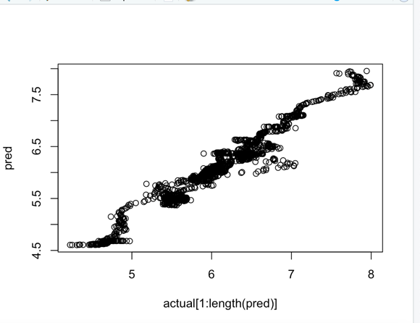
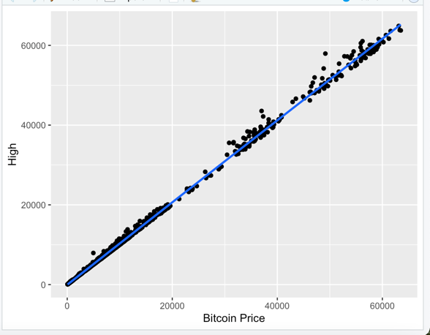

Slide 14

Discussion ?
We'd want to employ deep learning networks like Long-Short Term Memory (LSTM) and Generative Adversarial Network (GAN) for more efficient and accurate forecasting because financial data is usually non-stationary and non-linear.

Slide 15
THANK YOU

